Slide 1
SIGNAL & SYSTEM
ASSIGNMENT - 2

Slide 2
GROUP MEMBERS ENROLLMENT NO.
Sayak Rana 510519108
Abhiroop Mukherjee 510519109
Hritick Sharma 510519114

Slide 3
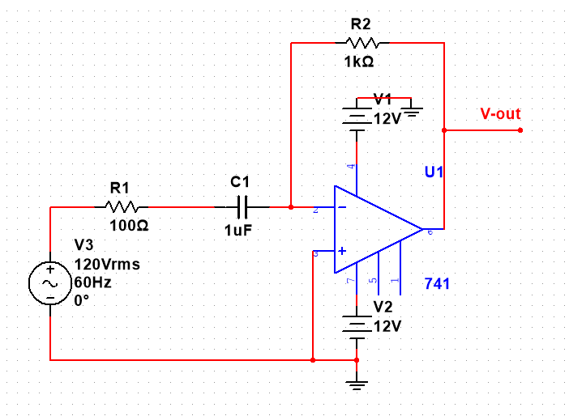
A. Perform frequency domain analysis for each of the implemented opamp circuits with R and/or C placed in both forward and feedback paths by giving a sweep from 10 Hz to 100 MHz. Choose component dimensions carefully and use spectrum analyzer, Bode plotter etc and also means to obtain Fourier coefficients. Try to explain the frequency domain behaviour from first principles.
DIFFERENCIATOR:
CIRCUIT:

Slide 4
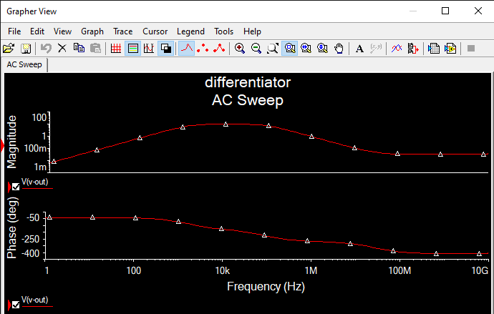
GRAPHER VIEW:

Slide 5
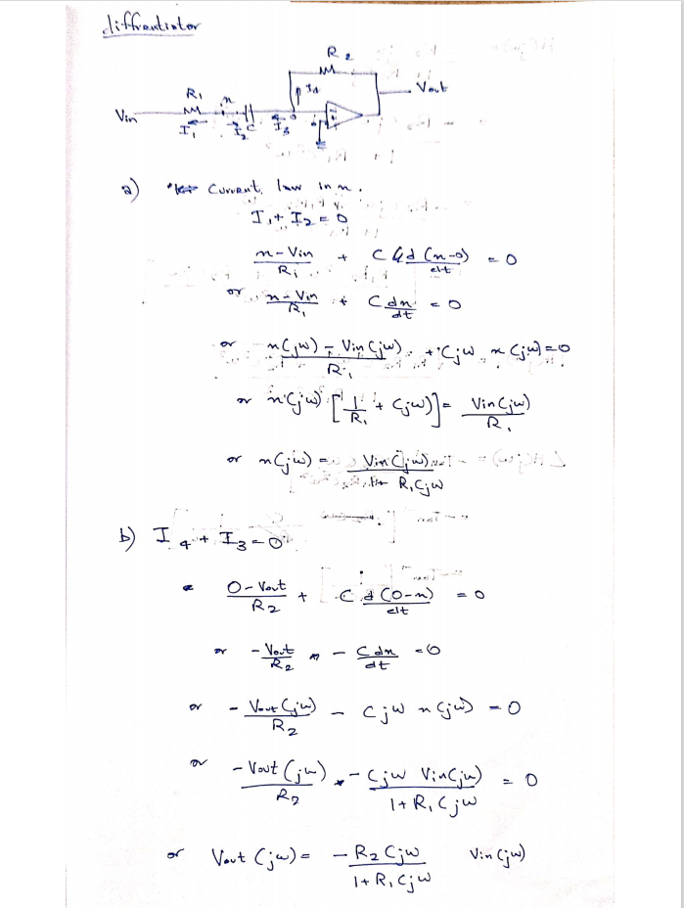
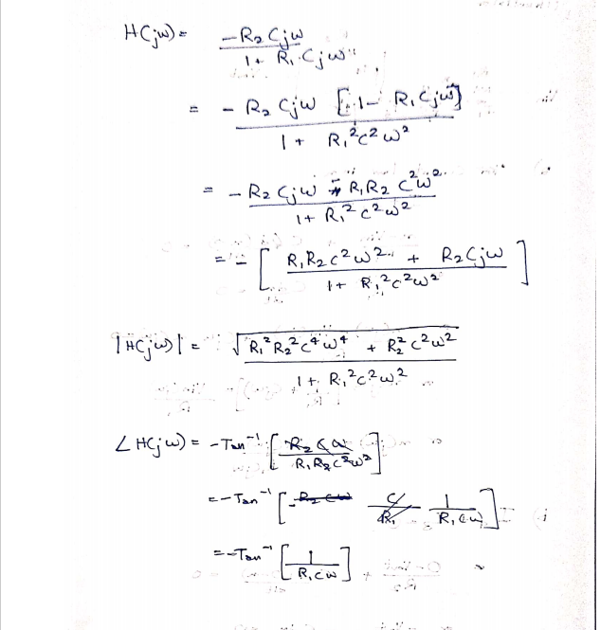
EXPLANATION:

Slide 6
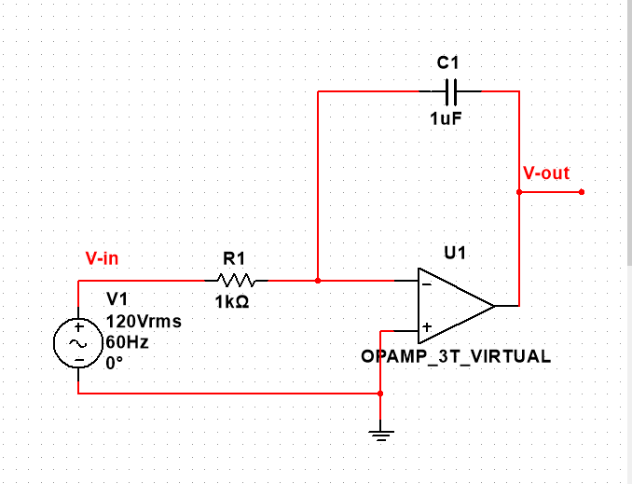
INTEGRATOR:
CIRCUIT:

Slide 7
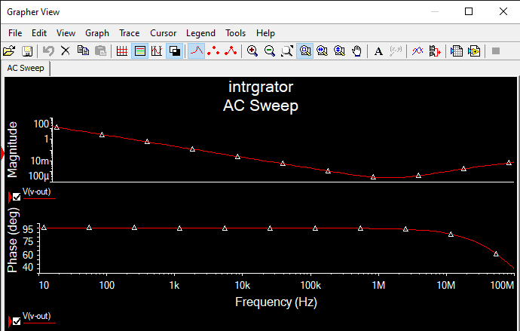
GRAPHER VIEW:

Slide 8
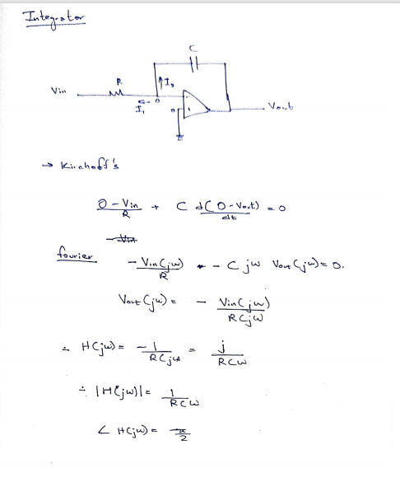
EXPLANATION:

Slide 9
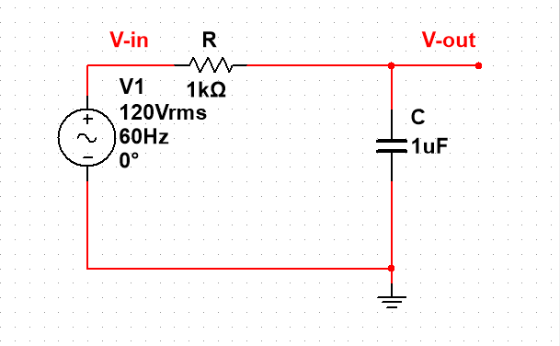
B. Plot the magnitude vs frequency and phase vs frequency from theoretical circuit analysis and compare with the obtained frequency response. Implement the obtained formula in excel or write C code to suitable for Bode plot. Comment on the match and departure between the theoretically obtained response and that obtained from the simulation environment.
CIRCUIT:

Slide 10
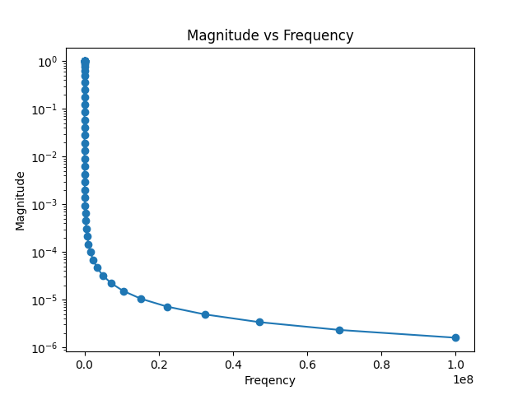
GRAPHS:
Exported from Simulator
Plotted By Code

Slide 11
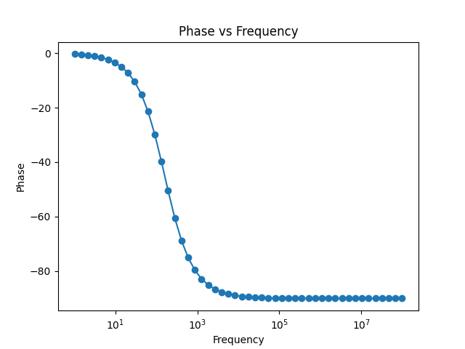
Exported from Simulator
Plotted By Code

Slide 12
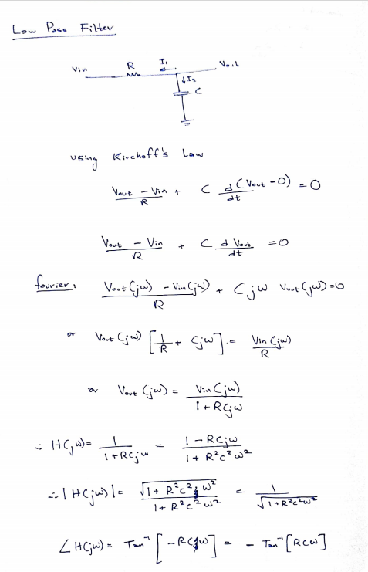
EXPLANATION:

Slide 13
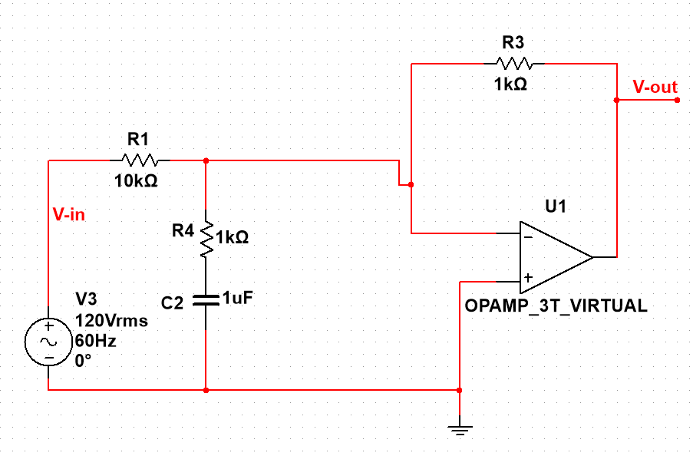
C. Demonstrate how the frequency response of PID circuit resembles behaviour of lowpass, highpass and bandpass filters. Note the range and nature of passband frequency zone. Note the slope with which the response rises or falls from passband to stopband. Establish the relation between circuit components and gain, phase, slope of the frequency response behaviour.
CIRCUIT:(LOW PASS)

Slide 14
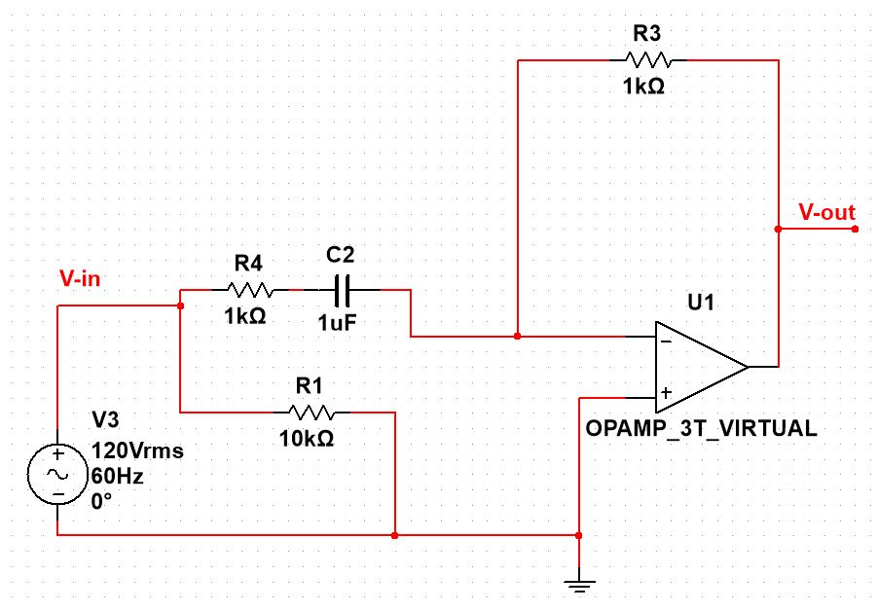
CIRCUIT:(HIGH PASS)

Slide 15
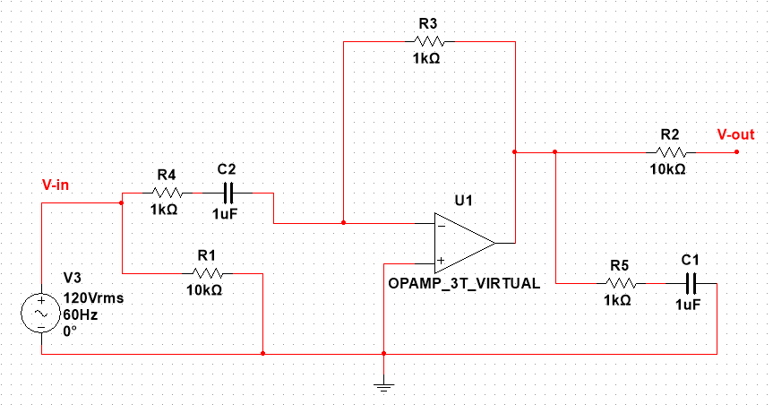
CIRCUIT:(BAND PASS)

Slide 16
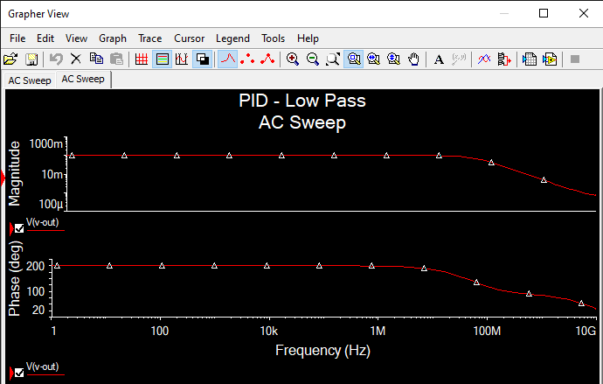
GRAPHER VIEW:(LOW PASS)

Slide 17
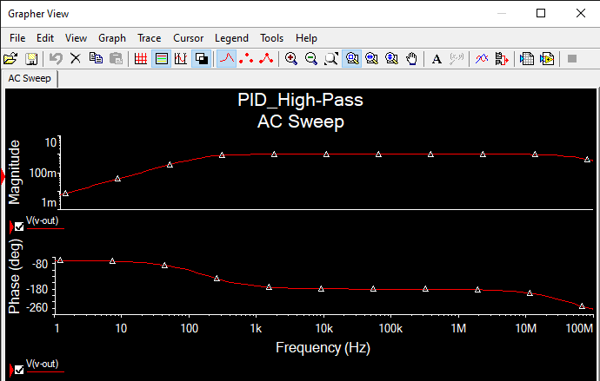
GRAPHER VIEW:(HIGH PASS)

Slide 18
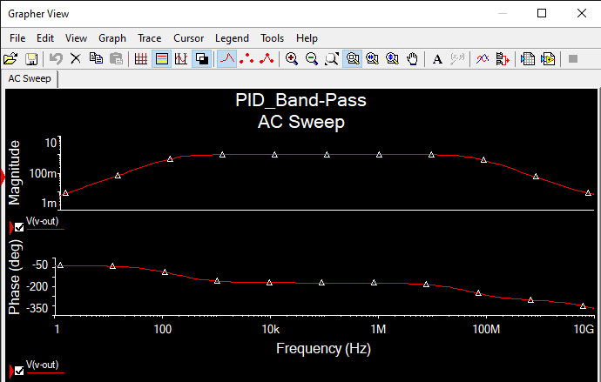
GRAPHER VIEW:(BAND PASS)

Slide 19
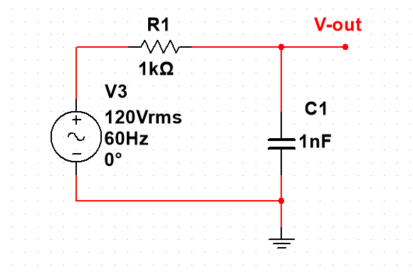
D. Show how the generic frequency shaping filters can be designed for desired cutoff frequency and report the corresponding frequency domain characteristics. Study and explore first the theoretical design and then implement by choosing the circuit components. You can try for lowpass, highpass and bandpass filters.
CIRCUIT:

Slide 20
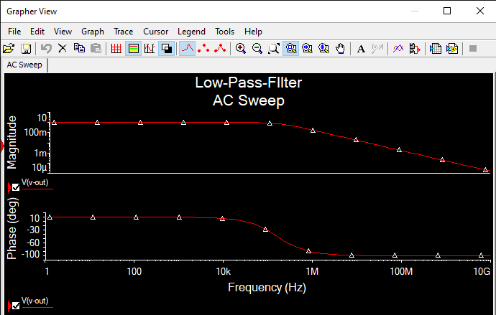
GRAPHER VIEW:

Slide 21
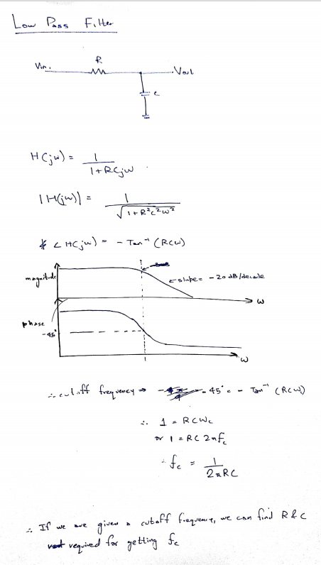
EXPLANATION:

Slide 22
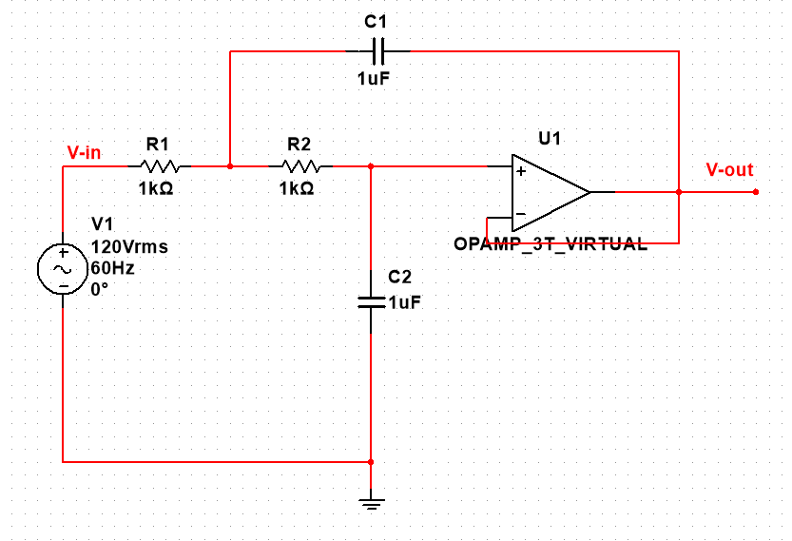
E. Increase the filter order for lowpass filter and demonstrate that the slope of cutoff zone indeed gets sharper with increase in order of the filters. Use Butterworth filter design approach.
CIRCUIT:(2ND ORDER)

Slide 23
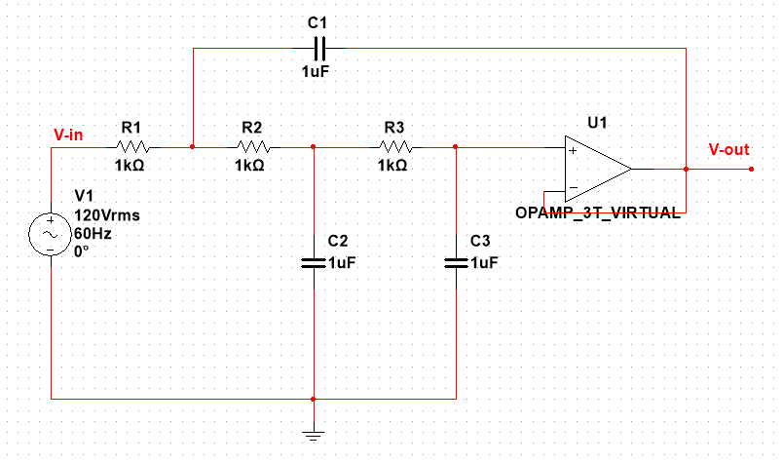
CIRCUIT:(3RD ORDER)

Slide 24
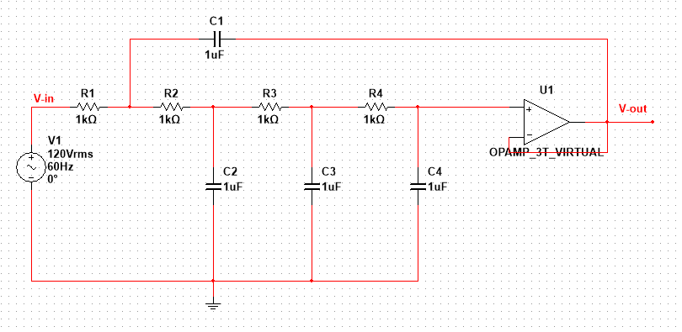
CIRCUIT:(4TH ORDER)

Slide 25
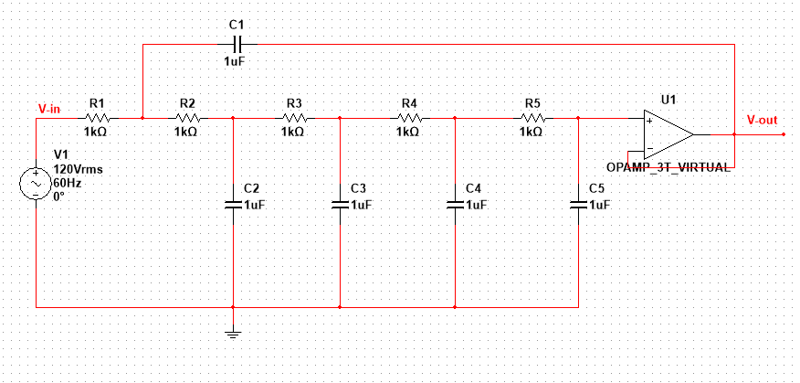
CIRCUIT:(5TH ORDER)

Slide 26
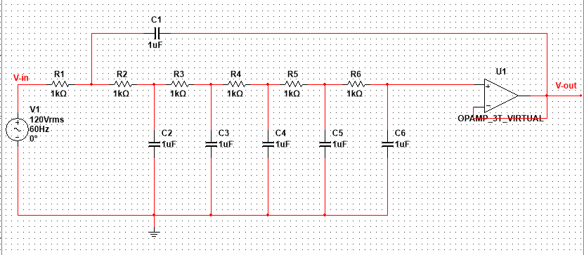
CIRCUIT:(6TH ORDER)

Slide 27
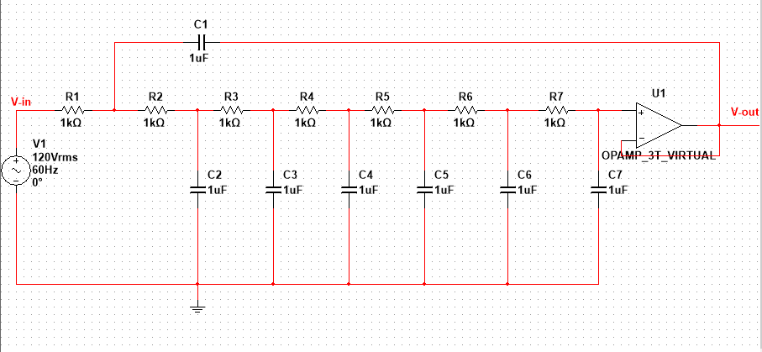
CIRCUIT:(7TH ORDER)

Slide 28
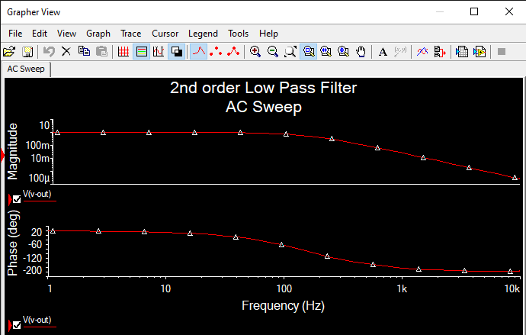
GRAPHER VIEW:(2ND ORDER)

Slide 29
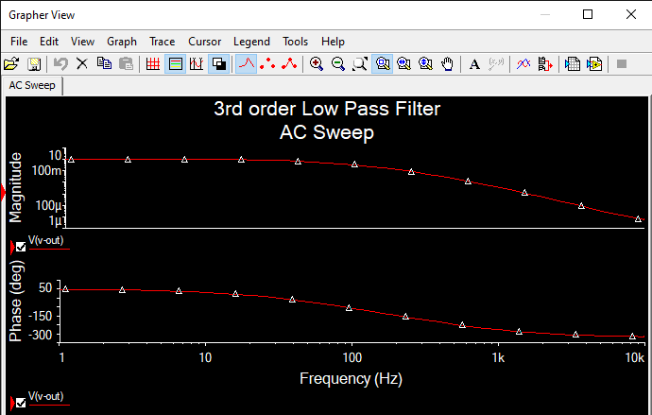
GRAPHER VIEW:(3RD ORDER)

Slide 30
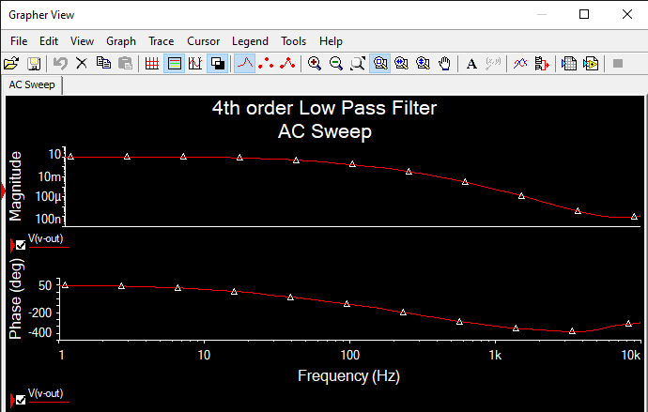
GRAPHER VIEW:(4TH ORDER)

Slide 31
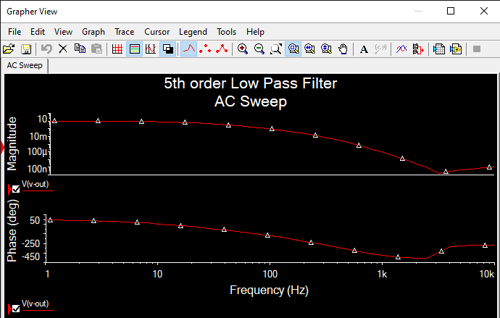
GRAPHER VIEW:(5TH ORDER)

Slide 32
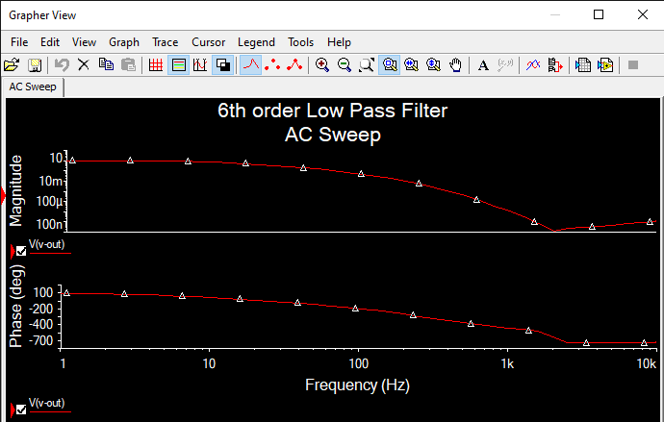
GRAPHER VIEW:(6TH ORDER)

Slide 33
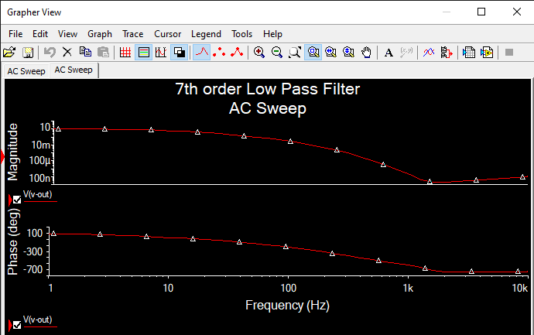
GRAPHER VIEW:(7TH ORDER)

